Slide 1

Gun violence analysis in US
Team 3
Andrew Roche Saurabh Goyal
Ashkan Dehghani Ky Nguyen

Slide 2


Motivation and summary

Slide 3
Core Message
There are outside factors that have an influence on gun violence in the United States
Motivation: The reason we chose this as our project and are asking this main question; is because with the escalated coverage of gun violence in the media, it has become a hot topic worldwide. If it’s possible to find influence on gun violence, is it possible to put measurements in to place to help lower said gun violence?

Slide 4


Questions and data

Slide 5
Questions
The question we asked is whether the season has any influence on the amount of gun violence.
The reason we asked this question is because when we were deciding on our project we found a line graph of overall crime that showed crime is way more frequent in the summer so we thought it would be interesting to find if that applies to gun violence as well.
The question we asked was whether the gender has an influence.
This might seem like an obvious conclusion, but that’s an interesting question in itself. Just because it seems obvious, does that make it true?
Our question is does the average household income per county have an influence on the amount of gun violence in that county.
We asked this question because we thought that there would be more incidents of gun violence in lower income areas.

Slide 6
Data sources
In order to answer our questions we obtained a data set between 2015-2017 from:
Kaggle.com -> gun violence incidents
Bureau of Economic Analysis-> per capita income by county in the U.S.
factfinder.census.gov -> Population of every city or county in the U.S
Google API -> county info, corresponding to US cities

Slide 7


Data cleaning & Exploration

Slide 8
Data exploration and cleanup process
Data Exploration
Types of files(Csv, excel)
Cleanup Process
Copy the required columns from main DF to another dataframe to avoid conflicts and work on different problems
Extract month and Year from date
API Data
Data Types
Junk data in the files
Grouped incidents by county using google API
Grouped the data by State, City, County, Average per-capita income, Gender to get our questions answered
Used top 100 counties out of 3142 counties across US
Count of rows and columns
Data anomalies (City/count)

Slide 9
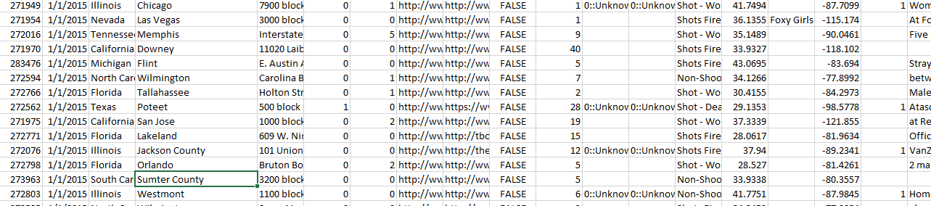
County and city issue:

Slide 10


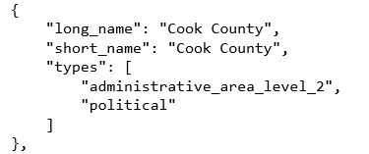
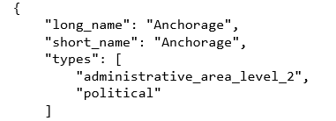

Cleanup example:

Slide 11

Data Analysis

Slide 12
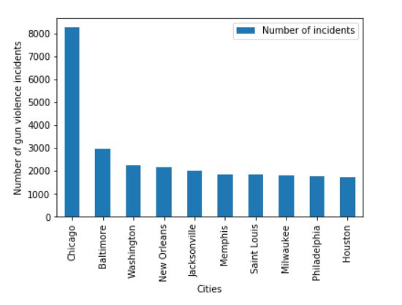
Location and avg income data Analysis
Top 10 cities based on number of incidents

Slide 13
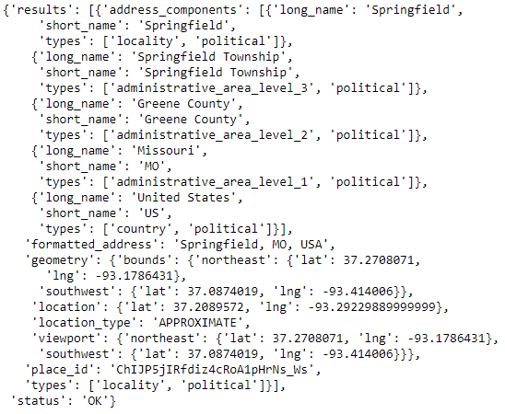
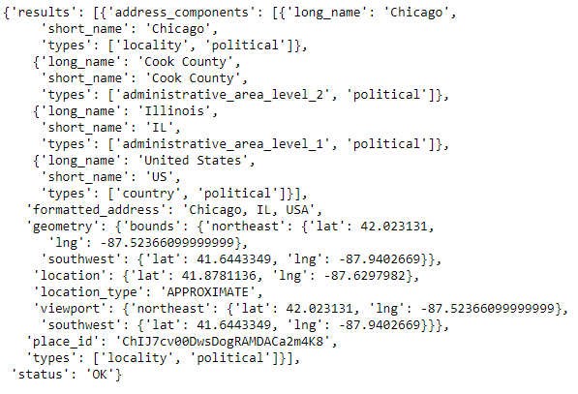
Extract -counties from cities using google API
0
0
1
1
2
2
3
3

Slide 14
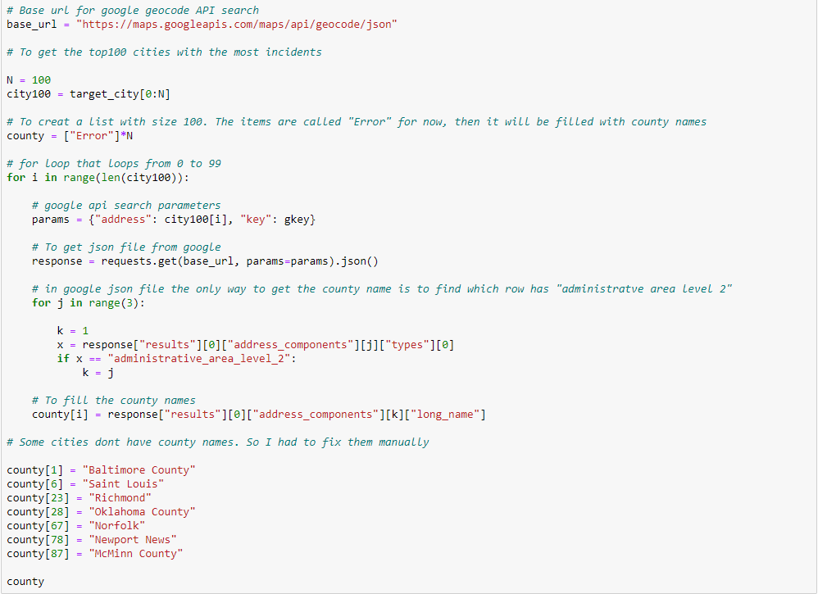

Slide 15
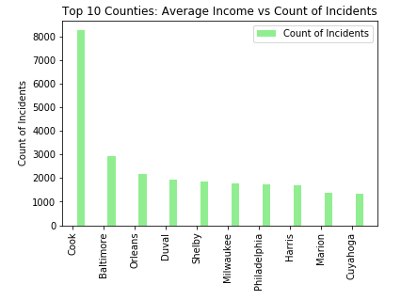
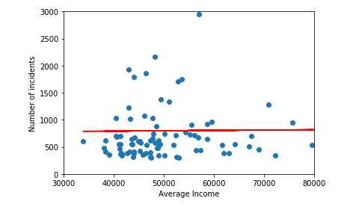
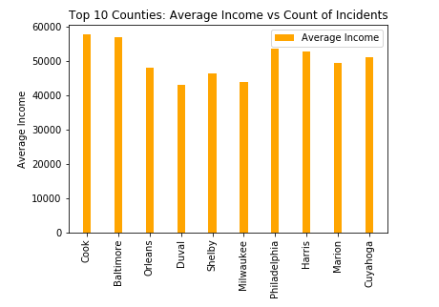
Avg Income vs Number of Incidents
R=Squared value = 0.01
Notes:
Discuss your findings.
Did you find what you expected to find? If not, why not?
What inferences or general conclusions can you draw from your analysis?

Slide 16
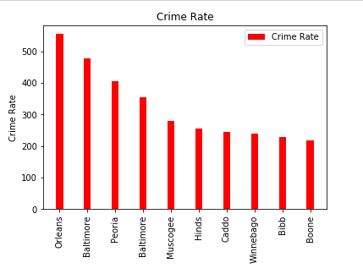

Slide 17
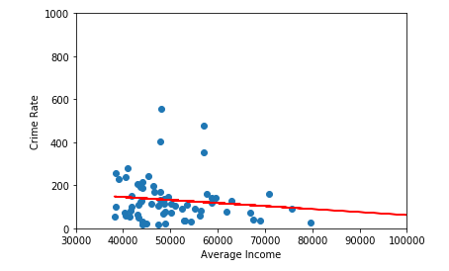
Avg Income vs Crime Rate

Slide 18
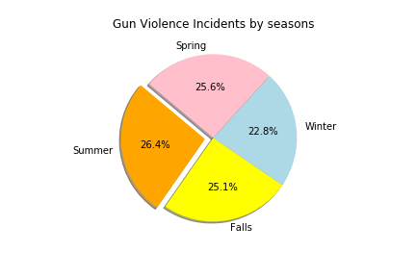
Gun Violence by Season
Summer is the highest season
Winter is the lowest season
No significant difference between seasons

Slide 19
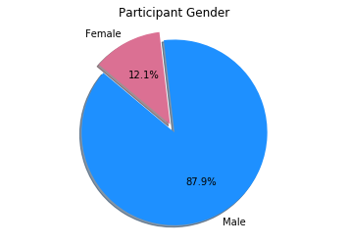
Gun Violence by Gender

Slide 20
Interesting findings

Slide 21
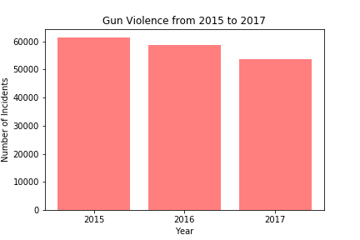
Gun Violence decreasing from 2015 to 2017

Slide 22
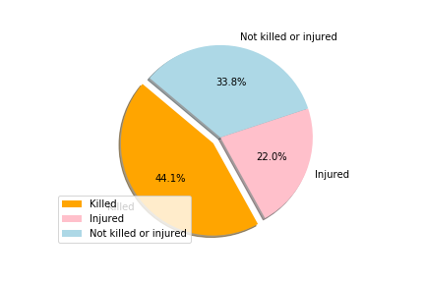
Fatal record:

Slide 23

Post Mortem

Slide 24
Post Mortem
We were working on making our code more perfect till last session together
We wanted to get full spectrum of charts available in other libraries, like Heat map to show the violence by counties or display them on the US map using Choropleth Map
Since our linear regression result didn’t had strong correlation, we wanted to use the complete data sets with 3142 counties but we choose top 100 for the most gun violence incidents due to issues with google api extract

Slide 25
Questions

